Slide 1

Electronics and Communication Engineering department
Autonomous drone-based disaster management and relief system
Review-II
REVIEW DETAILS
MEMBERS OF GROUP
GUIDE DETAILS
HOD DETAILS
V. Sai Eshwar (11229C012)
Narendra Babu (11229C009)
Dr. V. Jayapradha
Assistant Professor
Department of ECE
SCSVMV
Dr. G. Senthil Kumar
Head of the Department Department of ECE
SCSVMV

Slide 2
ABSTRACT
This project presents a NavIC-guided AI-based autonomous drone system developed for disaster relief in remote and inaccessible regions. Unlike conventional UAVs that rely solely on GPS, the proposed system integrates dual navigation using NavIC and GPS, ensuring reliable operation even in signal-degraded environments. The drone employs AI-driven path planning using the A* algorithm, enabling real-time obstacle avoidance and dynamic rerouting.
A key innovation is the integration of geofencing and regulatory compliance directly into the navigation system, allowing safe and autonomous operation without external supervision. The hardware platform includes a Pixhawk 6X flight controller, NVIDIA Jetson Nano for onboard AI processing, and a multi-sensor setup with LiDAR and camera modules.
The system is capable of delivering up to 5 kg of medical supplies using a GPS-tracked parachute mechanism. Additional features such as aerogel-based thermal protection and IP67 waterproofing enhance reliability in extreme disaster conditions. Overall, the proposed system reduces response time, improves navigation reliability, and minimizes human risk, making it a scalable and next-generation solution for intelligent disaster response.

Slide 3
LITRATURE SURVEY
Category | Study / System | Key Features | Limitations | Research Gap Identified
Disaster UAV Applications | Zipline (2021) | Real-world drone-based medical delivery using GPS | No AI-based routing, limited adaptability in dynamic environments | Need intelligent and adaptive routing system
 | Nepal Earthquake UAVs (2015) | UAV-based disaster mapping and surveillance | Fully dependent on GPS, lacks autonomous navigation | Requires robust navigation in degraded signal conditions
 | ResponDrone (EU Project) | Integrated platform for emergency response operations | No indigenous navigation support, limited autonomy | Need region-specific navigation + AI integration
 | CLARKE Project | Modular UAV system for disaster management | Requires manual mission planning | Need fully autonomous mission execution
Navigation Systems | GPS-based Navigation | Global coverage, widely adopted | Signal loss in dense/disaster areas, prone to interference | Need multi-constellation and reliable navigation
 | NavIC System | Indigenous system, high regional accuracy, dual-frequency | Limited adoption in UAV applications | Integration with UAV systems required
 | DGCA Drone Rules (2021) | Defines geofencing and restricted zones | Compliance handled externally, not autonomous | Need real-time embedded compliance system
Technology Developments | Aerogel Protection (NASA) | High thermal resistance (~1200°C), lightweight insulation | Not widely implemented in UAV systems | Need integration for extreme disaster conditions
 | AI Path Planning (A*, YOLO) | Enables obstacle avoidance and autonomous routing | Often used independently, not integrated with compliance | Need unified AI-navigation framework
 | GPS-Tracked Payload Delivery | Real-time tracking and monitoring | Limited autonomous deployment mechanisms | Need smart and automated delivery systems

Slide 4
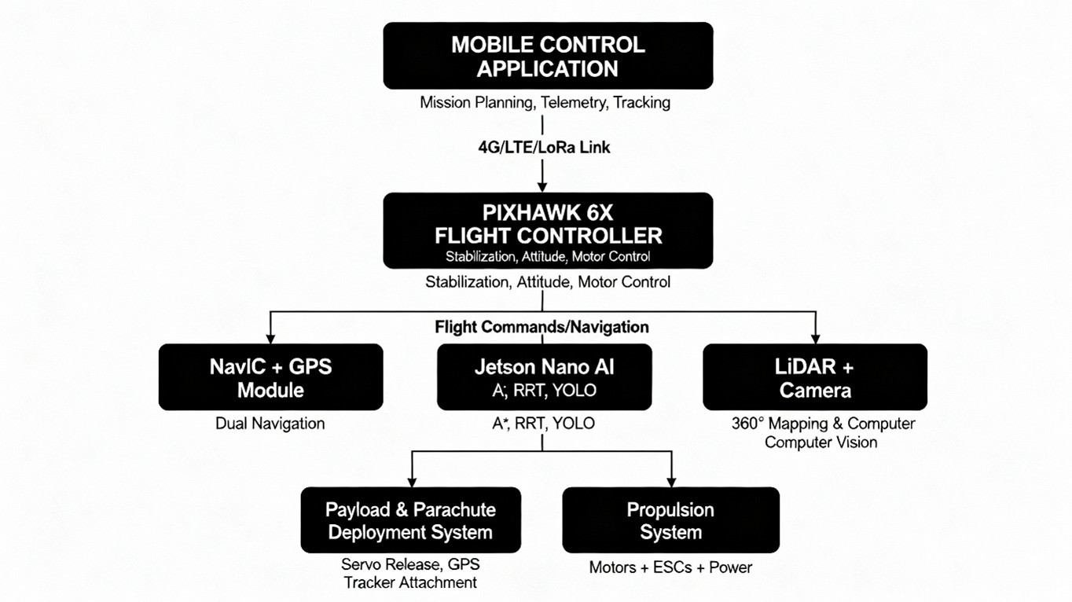
METHODOLOGY

Slide 5
PROGRESS SO FAR AND NEXT PHASE
Progress So Far:
Developed a working quadcopter drone prototype
Completed manual flight testing for stability and control validation
Successfully tested key flight modes:
Stabilize Mode
Altitude Hold Mode
Loiter / Hover Mode
Achieved basic automated functionalities for controlled flight performance
Next Phase:
Integrate autonomous navigation system into the prototype
Implement:
AI-based path planning
Obstacle detection & avoidance
Real-time decision-making
Simulate an autonomous hexacopter drone
Tools: Gazebo / NVIDIA Isaac Sim
Focus on enhancing payload capacity, stability, and robustness

Slide 6
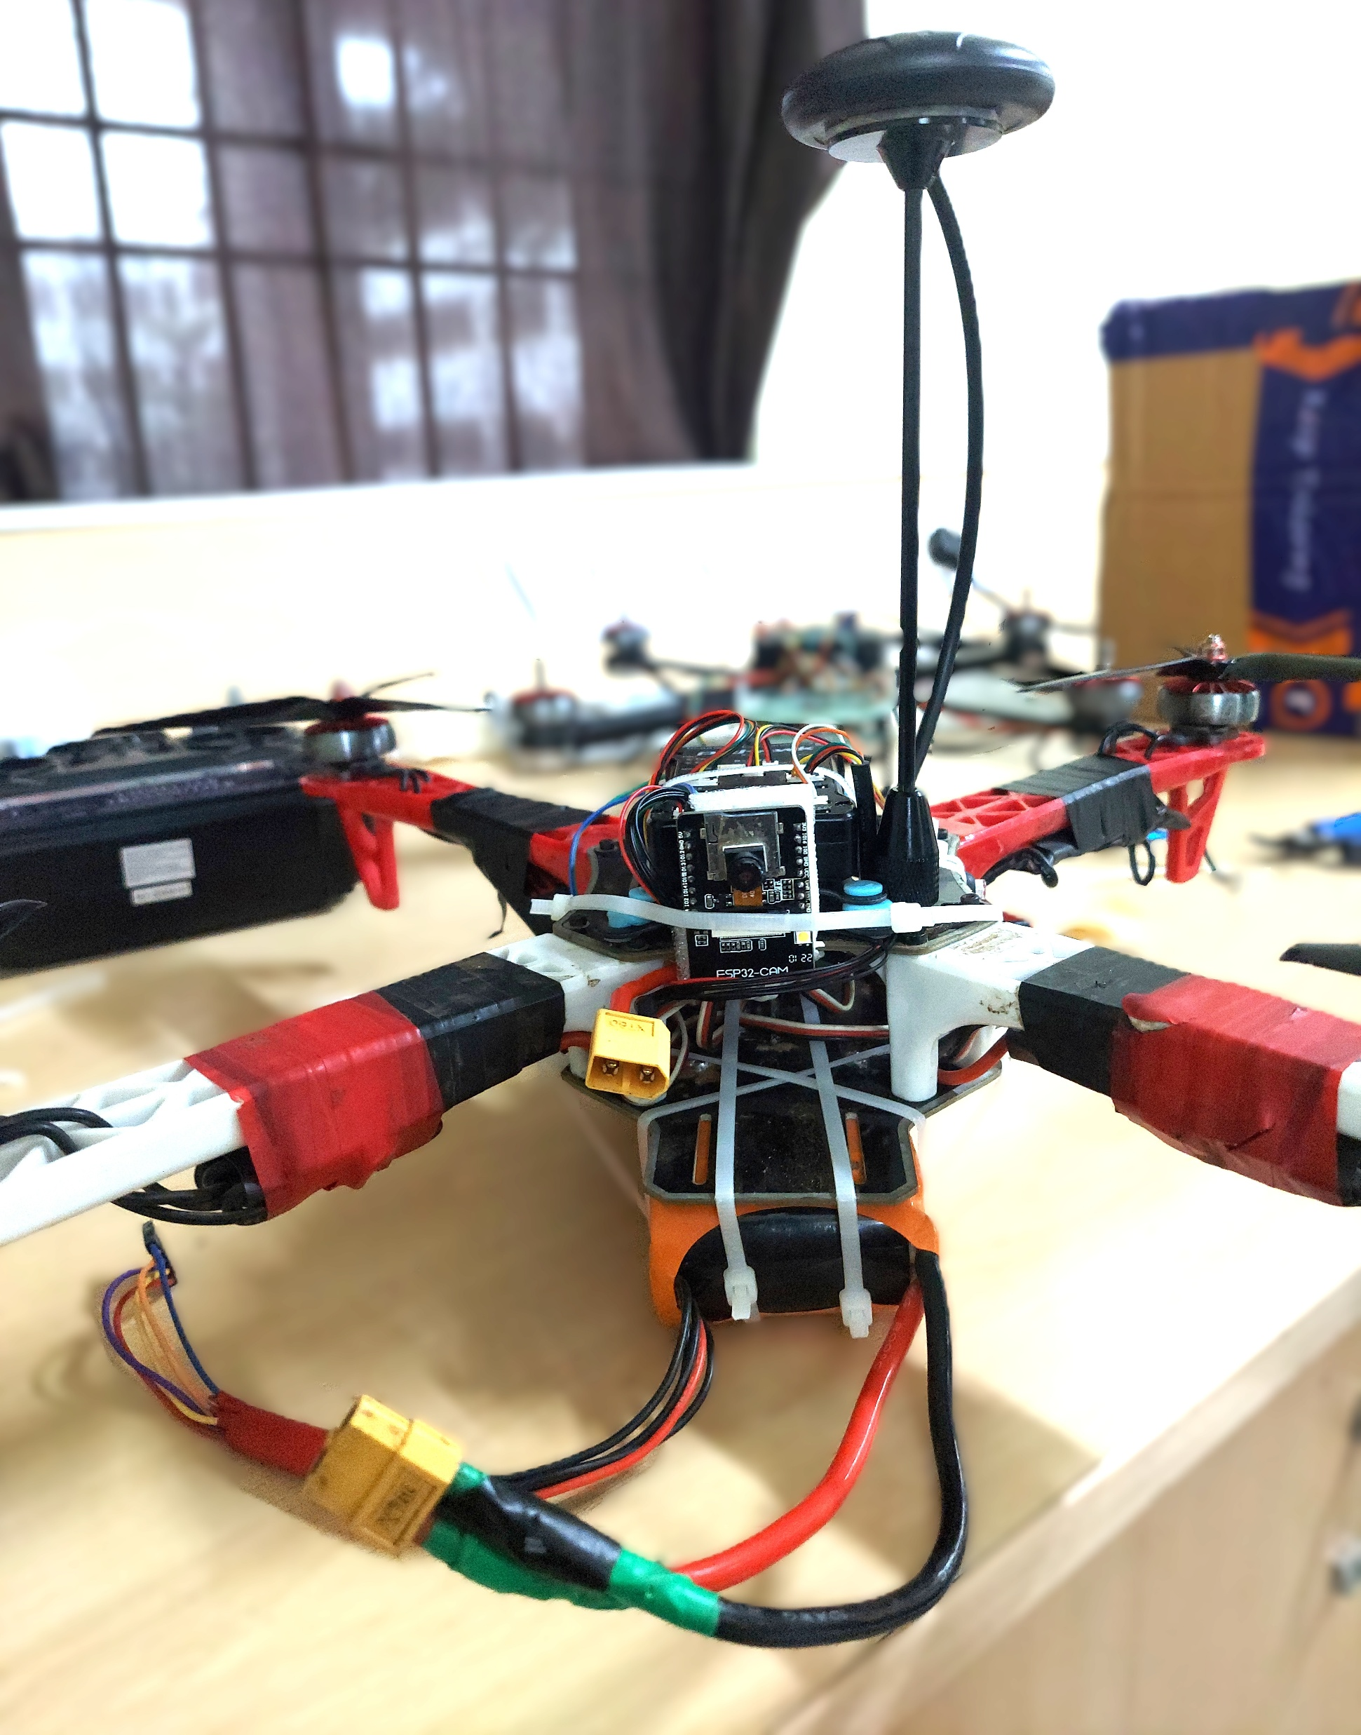
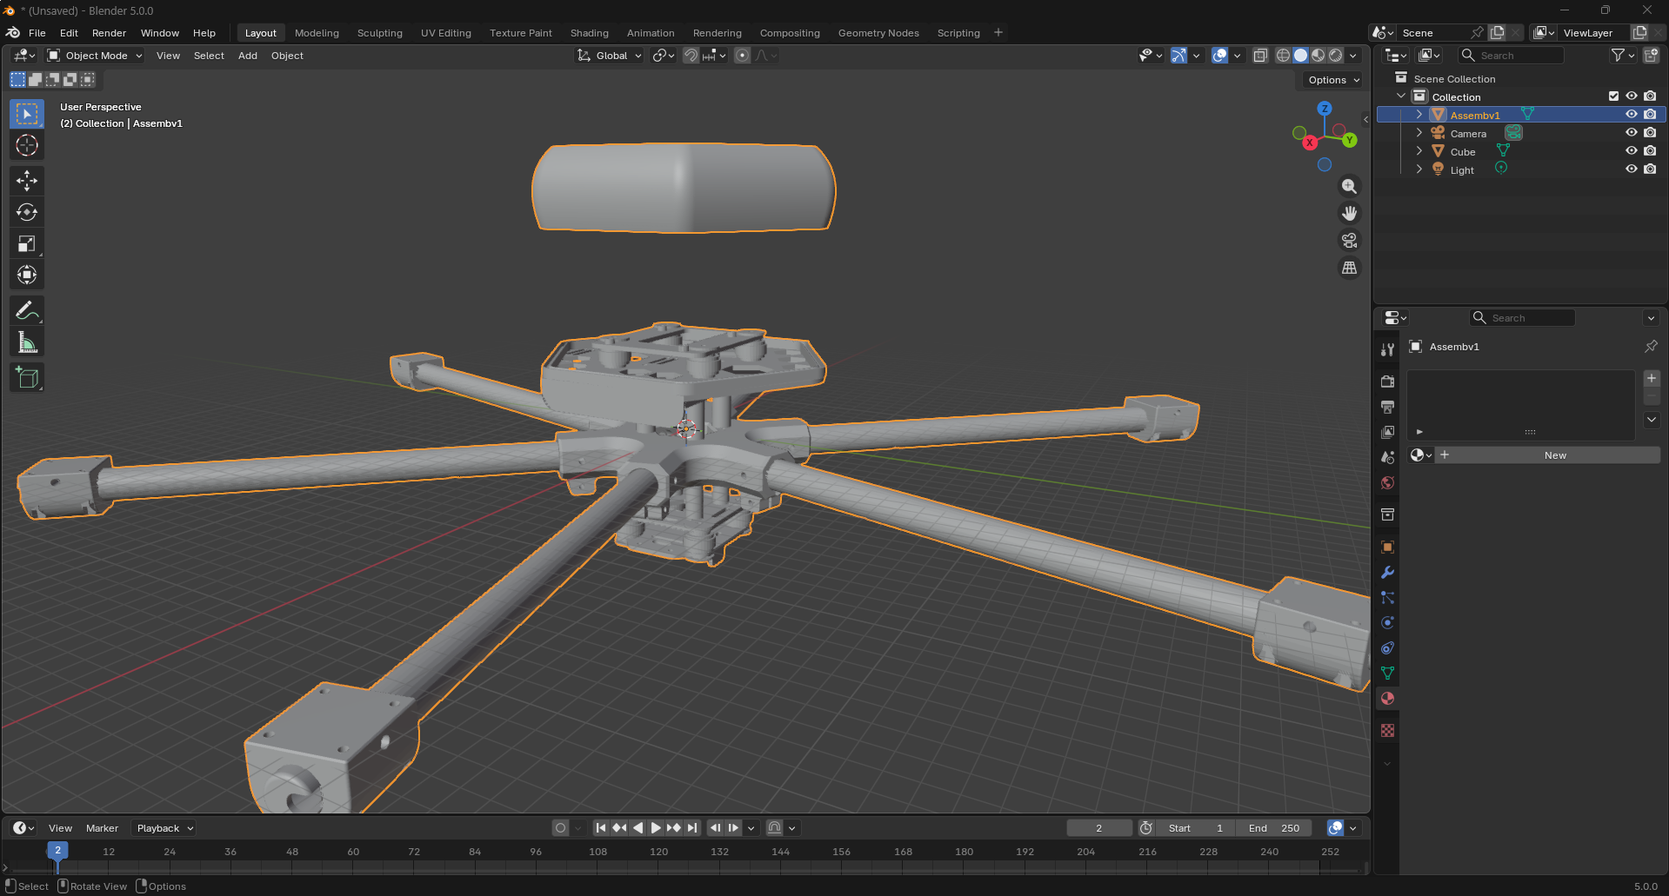
OUTPUT

Slide 7
REFERENCES
Y. Chang, J. Park, and H. Kim, “A Review of UAV Autonomous Navigation in GPS-Denied Environments,” Journal of Navigation Systems, 2023.
Z. T. AlAli and A. El-Dahrawy, “The Role of UAVs in Disaster Management: Recent Progress and Challenges,” Heliyon / Computers & Geosciences, 2022.
P. R. Thomas and P. Sarhadi, “Geofencing Motion Planning for UAVs Using Anticipatory Range Control Algorithm,” Machines, vol. 12, no. 1, 2024.
Y. Sheng, “UAV Autonomous Navigation Based on Deep Reinforcement Learning,” Drones, vol. 8, no. 9, 2024.
Indian Space Research Organisation (ISRO), “NavIC – Satellite Navigation System Overview,” 2022–2023.
ISRO Press Release, “NVS-02: Advancing India’s Regional Navigation Capabilities,” Jan 2025.
Zipline International Inc., “Drone-Based Medical Delivery System,” 2021.
Government of India, “DGCA Drone Rules 2021,” Directorate General of Civil Aviation.

Slide 8
THANK YOU

